Slide 1
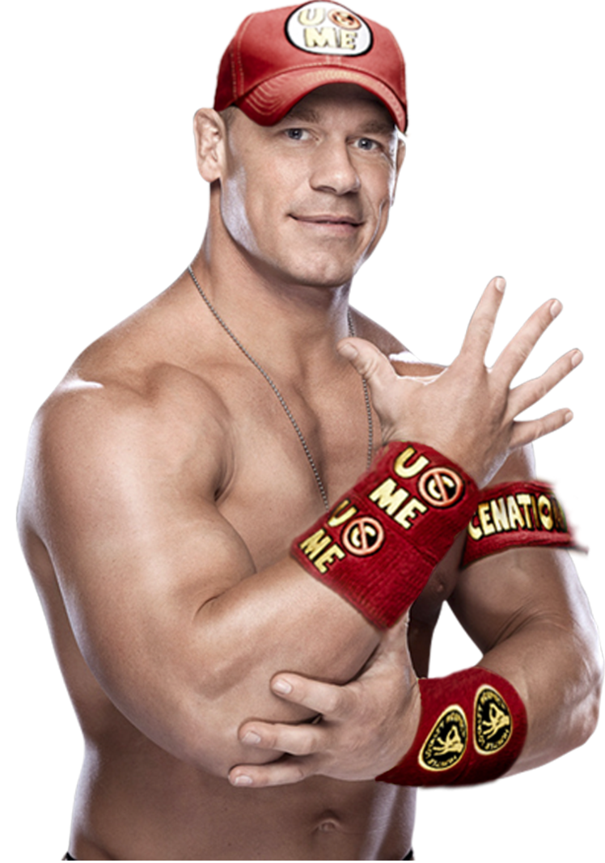

Team CHAMP
UCSC Meal Builder
Jason Zhao
Kevin Thai
James Luu
Glenn Dayton
Sam Fields
11/23
Not Actually Sponsored by John Cena

Slide 2
Summary
Did you know? At some on-campus eateries:
1 Meal = $8.00
Goals:
provide a way for students to maximize their meals and flexi-dollars by building meals in the app
provide a way for students to track their meals and flexi-dollars in the app
include menus of all on-campus eateries, excluding dining halls (which there is already an app for)
allow students to save meals as “favorites”
provide a way to update the app online

Slide 3
Challenges
Accomplishments
Team unfamiliar with Android Studio
Team unfamiliar with SQLite
We found it wasn’t feasible to have the app update automatically from the web, since most of the on-campus eateries don’t have post their menus online
Our original vision was for an app that would have the user select maybe one or two items, then automatically fill in the rest. We shifted slightly away from this by the end.
Team now familiar with Android Studio
Team now familiar with SQLite
Having a functional app
Having a way to track the user’s balance
Our app, instead of automatically crafting meals, helps users quickly create the meal they want by telling them what is within their price range every step of the way.

Slide 4
Technologies Used
Project Management Techniques
Backend: SQLite, SQLite Studio
Frontend: Android Studio, Java, XML
Frequent SCRUM meetings
Frequent group work sessions
GitHub and GMail

Slide 5
Enjoyed:
John Cena
Creating the app’s structure in Android Studio
Learning Android Studios and some Database stuff
Creating fully functional app
Team Management (SCRUM)
Being the CHAMP
Coming up with more ideas

Slide 6
Didn’t Enjoy:
Occasional lapses of communication
Android Studio being dumb
Unexpected Roadblocks
Time-Constraint

Slide 7
Worked:
Didn’t Work:
GitHub. We never had a problem merging code.
Frequent and immediate testing. Android Studio is great for this.
Pair Programming to help learn the Android SDK
Crunch Time
SCRUM and burn up chart kept us on track
Occasional lapses of communication
Meetings as a group
Weekends
Sticking to initial plans

